Slide 1
Sorority Jewelry Submitted by: The Alpha Omicron Chapter of Tau Beta Sigma Spring 2013

Slide 2
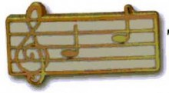
Prospective Member Pin
A gold pin enameled in white with a treble clef and 2 notes.
Identifies Membership Candidates of the Sorority.
It is to be worn in the same manner as the jeweled badge.
Exceptions can be further defined by the Membership Educator.

Slide 3
TBΣ Recognition Pin
A gold pin displaying the Sorority’s official coat-of-arms.
Members wear the “Cofa” as a means of recognition and signifying their commitment to the ideals of Sisterhood.

Slide 4
Enameled Recognition Pin
A colorized version of the Recognition Pin.
It is twice the size of the Recognition Pin.
It may be worn as an option to the Recognition Pin.

Slide 5
Crown Pearl Badge
This is the official means of identifying oneself with the Sorority.
Purchase of the official badge is optional.
The symbols on the badge have a special meaning to the members of the Sorority.

Slide 6
Official Key
This is a gold key inscribed with the Tau Beta Sigma flower and letters.
It is designed to be worn on a chain or key ring.
Only initiated members of the Sorority are permitted to use it.

Slide 7
Recognition Bar
This is a gold bar enameled in the Sorority colors of white and blue.
It is designed to be worn on band uniforms or sweaters.
Only initiated members of the Sorority are permitted to use it.
It is a means of identification and should be worn when visiting other college/university bands.

Slide 8
Life Member Pin
This is a gold circular pin with a blue enameled border.
On the border are the words Life Member.
In the center of the pin is the Tau Beta Sigma Crest.

Slide 9
Jewelry Etiquette
Pearl Badge, Prospective Membership Pin, Recognition Pin, Enameled Recognition Pin, Life Member Pin – may be worn on school clothes or dinner dress
Monogram Pendant/Official Key – May be worn with anything, but always in good taste
Rings, Necklaces, Bracelets, etc. - May be worn at any time
Wearing of other Pins – If a Sorority member is also a member of another Sorority/Fraternity, that pin is to be worn to the lower left of the Tau Beta Sigma pin.

Slide 10
SOMETHING TO REMEMBER!
Only initiated members of the Sorority may wear the Official Badge.
It is NOT to be exchanged with Fraternity members of other organizations.
Sorority pins and jewelry are to be worn by initiated members ONLY.
Prospective Members are not to wear the crest in any form until they are initiated.

Slide 11
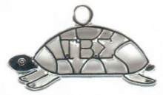
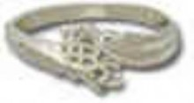
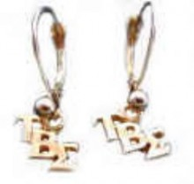
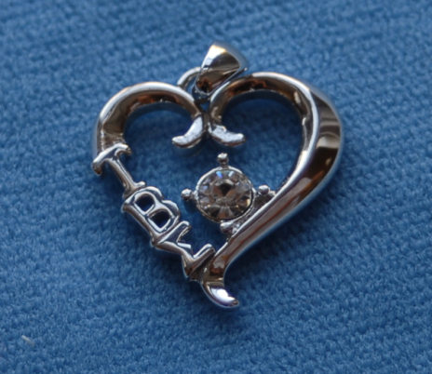
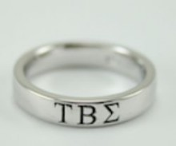
Other Jewelry
All pins and other Sorority jewelry can be found at www.tbsigma.org.

