Slide 1
National
NHQ
Submitted by: The Alpha Omicron Chapter of Tau Beta Sigma
Spring 2013
Headquarters

Slide 2
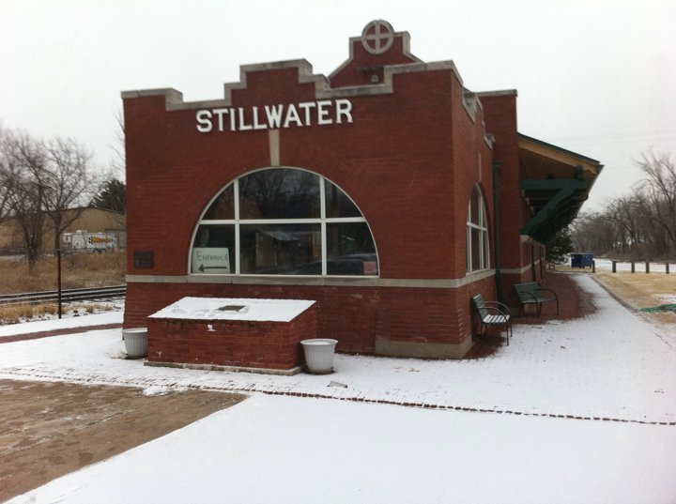
Where is National HQ Located?
For many years, the National Headquarters of Kappa Kappa Psi and Tau Beta Sigma was located in the Seretean Center for the Performing Arts on the campus of Oklahoma State University in Stillwater, Oklahoma.

Slide 3
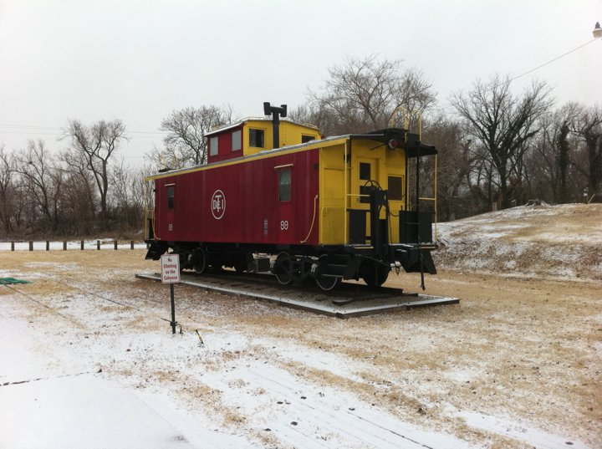
What was the building before it housed the National Headquarters?
In November 1991, the National Headquarters moved from the Seretean Center to Stillwater Station, a former Santa Fe Railway depot which had been purchased by the Sorority and Fraternity from a group of five Stillwater citizens who had bought the station at an auction in order to insure its preservation.

Slide 4
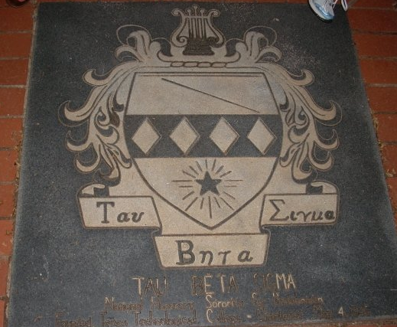
Where can you find the National Headquarters toll-free telephone number, mailing address, street address?
Kappa Kappa Psi / Tau Beta Sigma National Headquarters
P.O. Box 849 Stillwater, OK 74076
1-800-543-6505
kkytbs@kkytbs.org

Slide 5
National
Headquarters
Staff
KKΨ
&
TBΣ

Slide 6
Who is the National
Executive Director?

Slide 7
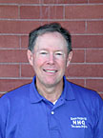
Lt. Col. Alan L. Bonner,
USAF (ret.)

Slide 8
The National Executive Director joined the staff in 1996 after a 26-year career in the Air Force which culminated with his four year tour as Commander and Conductor of the USAF Band & Washington, D.C. Col Bonner is responsible for the overall operations of the National Headquarters, promotes the Fraternity & Sorority nationally, and also provides the organizations with a direct link to university band directors around the nation.

Slide 9
What are his responsibilities?
The National Executive Director manages
  the business affairs of the Fraternity
  oversees the financial management of the organization
    including developing and monitoring the budget.
He/she also insures that the National Headquarters provides the necessary services to the membership in a professional, timely manner.
Other responsibilities include
  representing and promoting the Fraternity National Conventions
  maintaining direct contact with University Directors
  serving as the meeting planner for all National Conventions and National Council Meetings.

Slide 10
Who is the National Headquarters Office Manager and Accountant?

Slide 11
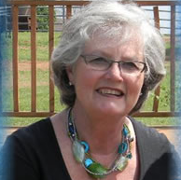
Diana (Di) Spiva

Slide 12
National Headquarters Office Manager and Accountant, joined the staff in 2000 from the Payne County Treasurer’s Office, where she was the bookkeeper. She and her husband, Stillwater’s former assistant fire chief, live on the family farm east of town. They have three sons, five granddaughters, two grandsons and a lot of barn cats. She cooks, sews, and plays the piano for her local church. Di is an Honorary Member of both National Chapters, an Honorary Member of the Alpha Chapters of Kappa Kappa Psi and Tau Beta Sigma and an Honorary Member of Kappa Kappa Psi and Tau Beta Sigma Southwest District.

Slide 13
What are her responsibilities?
Executive assistant to the National Executive Director.
He/She assists with supervising the Headquarters Staff and maintaining Stillwater Station.
Executes bookkeeping functions
  including payroll
  payment of bills
  preparation of monthly financial statements
  the upkeep of all money market accounts
  Alumni financial records
  all federal and state reports and tax payments.
Primary point of contact with the auditing firm for the annual audit.
Other responsibilities include
  working closely with National and District leaders to process Officer reimbursements and District requisitions
  making National Convention disbursements
  acquiring tax ID account numbers from the IRS for new chapters.

Slide 14
Who is the Membership
Services Coordinator?

Slide 15
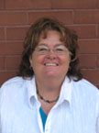
Debbie Morris

Slide 16
National Headquarters Membership Services Coordinator, is on her second tour-of-duty with National Headquarters. She came back after a three year hiatus of being a stay-at-home, mow the yard, tend the animals - wife, mother and grandmother. She originally started work in January 2001. She and her husband, Mark live on a farm. She has two daughters, Stacy and Jody. It is usually her voice you hear when you call National Headquarters. She does the data entry of initiates and the printing of their shingles and cards.

Slide 17
What are her responsibilities?
Maintains data base of
  records for all members
  National Offices
  District Officers
She is responsible for accounts receivable
  Dues
  Fees
  proceeds from supply sales
Creates the midyear and final year
  Chapter Status Reports
  District Allocation report.
Prepares and produces all
  membership cards
  shingles
  membership pins.

Slide 18
Who is the National and Colony Education Coordinator?

Slide 19
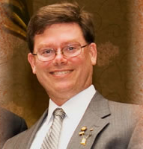
Dale Croston

Slide 20
Dale Croston, Chapter & Colony Education Coordinator, is a graduate of Oklahoma State University with a BS in Business Management. Dale is a Life Member of the Alpha Chapter and an Honorary Member of the KKΨ National Chapter, Southwest District, TBΣ National Chapter and the TBΣ Alpha Chapter. Dale is no stranger to KKΨ and TBΣ, since becoming a member in 1985, he has received the J. Lee Burke Student Achievement Award, Stanley G. Finck Memorial Award and the A. Frank Martin Award. As a student leader, Dale helped his chapter achieve the William A. Scroggs Founder's Trophy and the J. Lee Burke Trophy for best Chapter Display. Dale has held several Chapter and District offices, as well as, served on the National Alumni Association's Board of Directors. Dale plays Saxophone in the Stillwater Community Band and serves on their Board of Directors. In addition, he and his son Jared are actively involved in the Boy Scouts of America. His wife Lisa is also a Member of TBΣ and involved with the Sorority on many levels.

Slide 21
What are his responsibilities?
As the CCEC, Dale helps prepare all paperwork regarding
  chapters and colonies for the National Executive Director
Actively coordinates chapter and colony educational aspects for membership and developing MEP standards.
Works with the National Vice Presidents for Colonization
He also maintains colonization correspondence files
Submits monthly reports to councils and district leadership
Chapter correspondence and record management, reviewing chapter MEPs, and coordinating a chapter's recovery from Probation or Suspension Status.
Dale works with the National Vice Presidents for Colonization and Membership helping them to coordinate colonies and national programs.

Slide 22
Who is the National Alumni Historical and Developmental Coordinator?

Slide 23
Aaron Moore

Slide 24
Aaron is a 1998/2004 graduate of Northeastern State University, where he earned Bachelor’s Degrees in History Education and Telecommunications Management. During his time at NSU, Aaron was a member of the NSU Jazz Ensembles. He was initiated into the Alpha Rho chapter of Kappa Kappa Psi in the spring of 1999. As HQACC , Aaron helps prepare all paperwork regarding chapters and colonies for the National Executive Director. The HQACC also maintains records for all chapter investigations, is responsible for all data entry of Alumni records, and maintains circulation databases. Other responsibilities include coordinating mail-outs, handling all general Headquarters e-mail, maintaining colonization correspondence files, and monthly reports to councils and district leadership. In addition to being a Life Member of the Alpha Rho Chapter, Aaron is also an honorary member of the Alpha Chapter of Kappa Kappa Psi and the National chapter of Tau Beta Sigma. Aaron completed a Masters Degree in Public/Applied History with an emphasis in Museum Studies at Oklahoma State University in 2010.

Slide 25
What are his responsibilities?
Prepares all paperwork regarding chapters and colonies for the National Executive Director.
He/She maintains records for all chapter investigations.
He/She is responsible for all data entry for all Alumni records and maintains circulation data bases.
Other responsibilities include
  coordinating mail-outs,
  handling all general Headquarters e-mail
  maintaining colonization correspondence files
  monthly reports to councils and district leadership.

Slide 26
Who is the Publications
Manager?

Slide 27
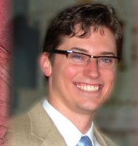
Nick Smith

Slide 28
National Publications Manager and Multimedia Designer is a 2008 graduate from the University of Arkansas, Fayetteville where he earned a Bachelor's of Fine Arts Degree in Visual Design with an emphasis in web and animation production. While at the University of Arkansas Nick was a member of the Razorback Marching Band, the University of Arkansas Wind Symphony and the Hogwild Basketball and Volleyball Bands. He was initiated into the Lambda chapter of Kappa Kappa Psi in the Fall of 2004. Nick is the editor and designer of The Podium, NewsNotes Online and several other publications as well as the webmaster in charge of general upkeep and design/redesign of all websites related to the fraternity and sorority. He also produces designs for awards and updates all membership materials, guides and constitutions for both organizations. Nick is a life member of the Lambda chapter, is an honorary member of the Psi chapter of Tau Beta Sigma and an honorary member of both the Southwest District of Kappa Kappa Psi and the Southwest District of Tau Beta Sigma.

Slide 29
What are his responsibilities?
Prepares all magazines, books, articles, and advertisements for the Fraternity.
He is editor and layout designer of The PODIUM
Coordinates the printing & mailing process with printers & mailers
He also revises, edits, and publishes all Fraternity books & manuals including the Guide to Membership, Ritual, all forms, and the on-line Chapter Directory.
He maintains the National website and manages the kkpsi.org email system.
He processes all National Awards, designs new awards and promotional materials, and prints Chapter charters and replacement and Life member certificates (’shingles’).

Slide 30
Who are the National Chapter Field Representatives?

Slide 31
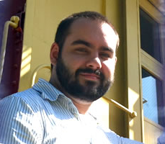
Zeb Watkins

Slide 32

A graduate of Butler University, where he received a
  Bachelor of Arts degree in Music.
An alumnus of the Alpha Beta Chapter
Served in a variety of leadership roles in the fraternity
  chapter president
  two terms as officer on the North Central District council.
Active in the Student Government Association
played bassoon and saxophone
Held memberships in the following
  National Association of Student Personnel Administrators;
  International Double Reed Society;
  National Association of Parliamentarians
  Kappa Kappa Psi Alumni Association.

Slide 33
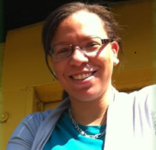
Yvone Day

Slide 34
2012 graduate of Virginia Commonwealth University
  Bachelors in Music Performance
    Bassoon
Recipient of the Outstanding Service Award for her graduating class
Initiated in Spring 2008 Kappa Psi chapter
  served two terms as chapter President
  2011-2012 Northeast Member at Large
Who's Who for College Students and MENC.

Slide 35
Describe the role of the National Chapter Field Representative.
Each Chapter Field Representative
  serves for 2 years
During which time she/he will travel
  180 days out of each year
  60,000 miles visiting
    130 chapters throughout the country.
The NCFR is an important link between the active membership of the Sorority and the National Council.
She/he also represents the Sorority at
  Midwest Clinic
  Texas Music Educators Association
  District conventions
  National convention.
Created and approved
  National Chapter of Tau Beta Sigma in 1993.
NCFR program was designed assist, educate, and motivate chapters and improve communications between the
  Chapters
  National Council
  National Headquarters
The general mission of the CFR is “to inquire, to analyze, and to inspire.”

Slide 36
FINIS

